Slide 1
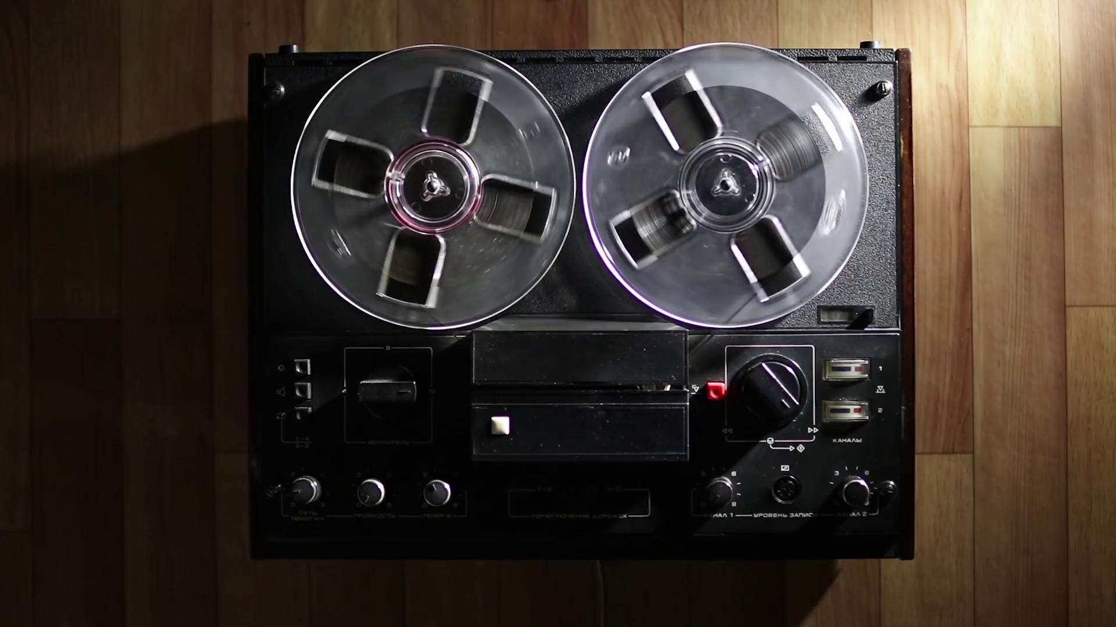
Rockbuster Stealth Data Analysis
2022 July 15
Albert Tran
Notes:
Image Reference: Old retro Reel Audio Recorder reels spinning Stock Video Footage 00:20 SBV-338650131 – Storyblocks

Slide 2


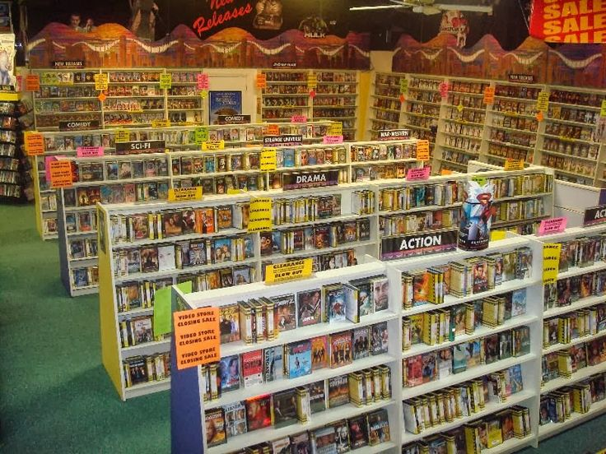
INTRODUCTION
Rockbuster Stealth LLC is a movie rental company that used to have stores around the world.
Rockbuster Stealth management team plans to use its existing movie licenses to launch an online video rental service.
Notes:
Picture reference: Movie Licensing for Public Use | Movie Umbrella License (insaneimpact.com)
https://www.youtube.com/watch?v=KPUTtJErxug

Slide 3
TABLE OF CONTENTS
Overview
Findings & analysis
Recommendations

Slide 4
Goals Developing a strategy for Blockbuster in order to launch itself into the online streaming services market. Tools SQL – To perform calculations within database. Excel – To notate queries and outputs. Tableau – To create Data Visualizations for Stakeholders.
1) OVERVIEW
Notes:
Consider talking about:
Reduce waste and complete projects on time
Document the right requirements
Improve project efficiency

Slide 5




KEY BUSINESS QUESTIONS
A
Which movies contributed the most/least revenue?
B
What was the average rental duration for all videos?
C
Which countries are Rockbuster customers based in?
D
Where are customers with a high lifetime value based?
E
Do sales figures vary between geographic regions?
Notes:
Consider talking about:
Enterprise analysis or company analysis
Requirements planning and management
Requirements elicitation
Requirements analysis and documentation
Requirements communication
Solution assessment and validation

Slide 6
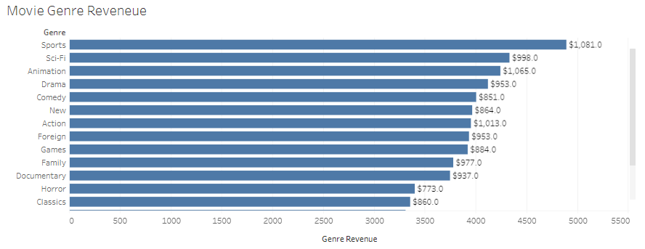
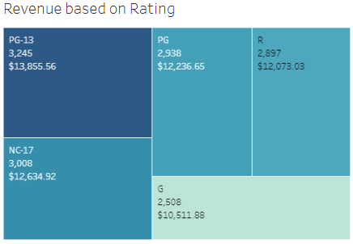
2A) MOVIE REVENUE
The movie genres with the MOST revenue are:
Sports
Animation
Action
Sci-Fi
Drama
The movie genres with the LEAST revenue are:
Classics
Horror
Documentary
Family
Games
PG-13 Movies are the most popular with $13,855.56 in revenue, whereas G rated movies are the least popular with $10,511.88 in revenue.

Slide 7
MOVIE GENERAL INFORMATION
Movie Language | Language Count | Language Revenue | Release Year(s)
English | 14,596 | $61,312.04 | 2006
All 14,596 movies in Rockbuster’s inventory are in English from the year 2006.
The total revenue from all the movies are $61,312.04.
One recommendation is to check with the other departments to see if there is a data-type issue to make sure if all our movies are in English from the year 2006. In this presentation we will continue as if general movie information is correct.
Another recommendation to break into the online streaming market is to expand consumer options by potentially adding movies in different languages and movies from other years as well.

Slide 8
2B) MOVIE DURATIONS
Rental Duration (in days)
 | Average | Minimum | Maximum
Expected Duration | 5 | 3 | 7
Actual Duration | 5 | 1 | 10
Rental Rate | $2.98 | $0.99 | $4.49
The actual rental duration differs from expected duration, meaning a fraction of total revenue comes from revenue accrued by late charges.
With online streaming services, late charges are no longer accrued. However, through online streaming services products become more accessible and cheaper to distribute using the internet.

Slide 9
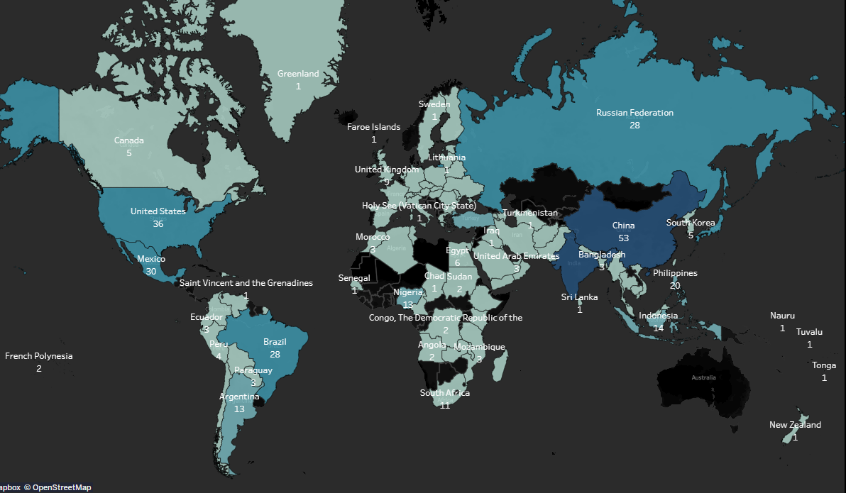
2C) CUSTOMER DEMOGRAPHIC
Top 5 countries with highest customer count
In total, Rockbuster Stealth LLC has customers in 108 different countries.
Country | Customer Count
India | 60
China | 53
United States | 36
Japan | 31
Mexico | 30

Slide 10
2D) HIGH LIFELINE CUSTOMER DEMOGRAPHIC
Customer | Country | City | Total Amount Paid
Casey Mena | Turkey | Tokat | $130.68
Sara Perry | Mexico | Atlixco | $128.70
Leslie Seward | Indonesia | Pontianak | $123.72
Alan Kahn | China | Emeishan | $119.75
Clinton Buford | United States | Aurora | $98.76
Theresa Watson | Philippines | Taguig | $86.81
Nellie Garret | India | Shimoga | $86.81
Phyllis Foster | China | Zalantun | $76.80
Joann Gardner | Turkey | Tarsus | $64.85
Scott Shelley | United States | Aurora | $60.82
Our highest paying customer lives in Turkey.
In addition, 4 of our highest paying customers live in China and the United States with an equal distribution.

Slide 11
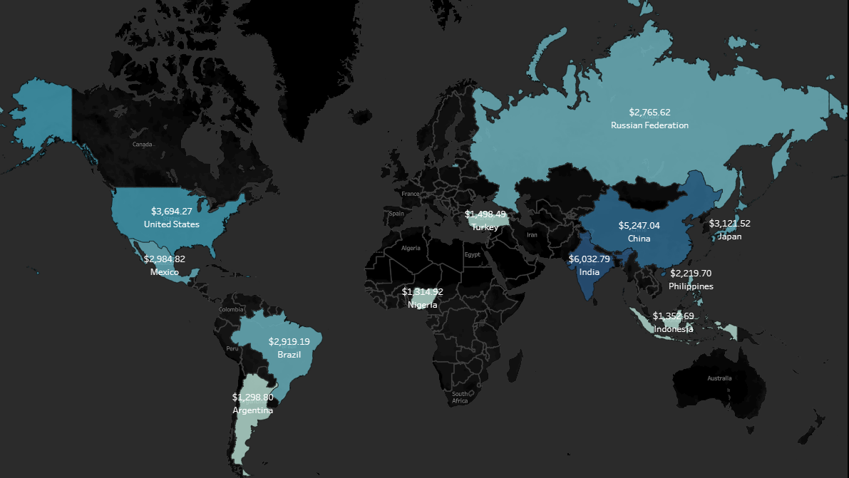
2E) REGIONAL SALES FIGURES
Top 5 Highest Revenue Counties
Regional sales differ from country to country.
Country | Revenue
India | $6,032.79
China | $5,247.04
United States | $3,694.27
Japan | $3,121.52
Mexico | $2,984.82
The highest revenue counties are the same countries with the highest customer count.

Slide 12
3) RECCOMENDATIONS
Diversify our products
Focus on high-revenue regions
Our movie products only consist of English movies released in the year 2006.
By adding movies in other languages, we can attract new consumers who do not speak English.
Sports
PG-13
Business Model
With most of our consumers living in India, China, and the US. We can potentially focus on adding popular movies from these regions in their retrospective language.
Genre & Rating
Product Expansion
Rental Rate
Regional Focus
Focus on popular genres and ratings
Determine our pricing strategy
India,
China,
US
Multi-
lingual
With online streaming services, we lose a section of our revenue stemming from late returns. In order to combat this loss in revenue Rockbuster would need to either increase the price per rental or determine a fitting subscription price.
We should focus on adding new movies that generate the most revenue such as PG-13 & Sport movies in order to keep our existing customer base interested.

Slide 13
Thank you!
Link to visualizations:
https://public.tableau.com/app/profile/albert.tran/viz/Rockbuster_16582478158180/Story1

